Slide 1
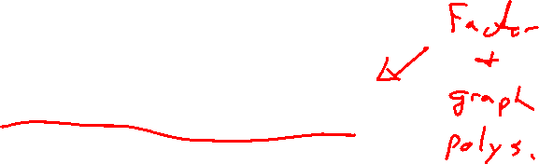
Section 3.3 Dividing Polynomials
Lecture 1
Reliving the Past: Long Division
Notes:
Note, skip 2.5, more on lines, focus is on thinking linear. Similar ideas to previous lectures

Slide 2

Homework Submission to Canvas
Preview of section
Skim the section in text and write a short paragraph summary.
Give a bulleted list of all important definitions, theorems, and formulas without details.
Notes on video lectures
Take notes on everything written on slides including all details, worked examples, on-own activities, as well as your own thoughts and questions.
Try on-own activities first, then write down provided solution next to it for comparison.
Worked examples from the text
Write down the problem and attempt without looking at the solution.
Use the solution to write the best explanation you can.
Solutions to textbook exercises
Model approaches and explanations given in the video lectures and textbook examples.
Final reflection of section
List the key takeaways to remember as a bulleted list.

Slide 3
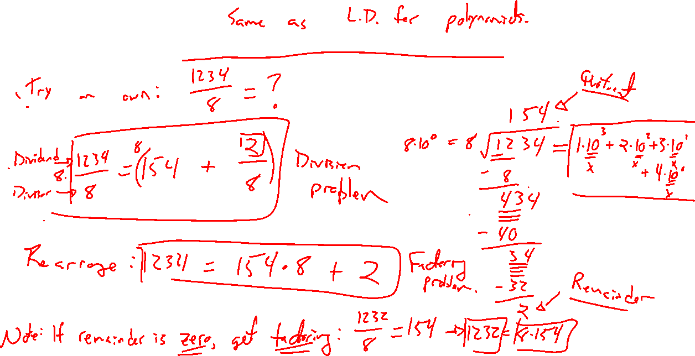
Example: Long Division for Numbers
Notes:
Try on own: 1234/8 = 161 + 6/8
Remainder. Can rewrite as 1234 = 8*161 + 6
If remainder is zero, division is really factoring: 1228/8 = 161 is same as 1228 = 8*161

Slide 4
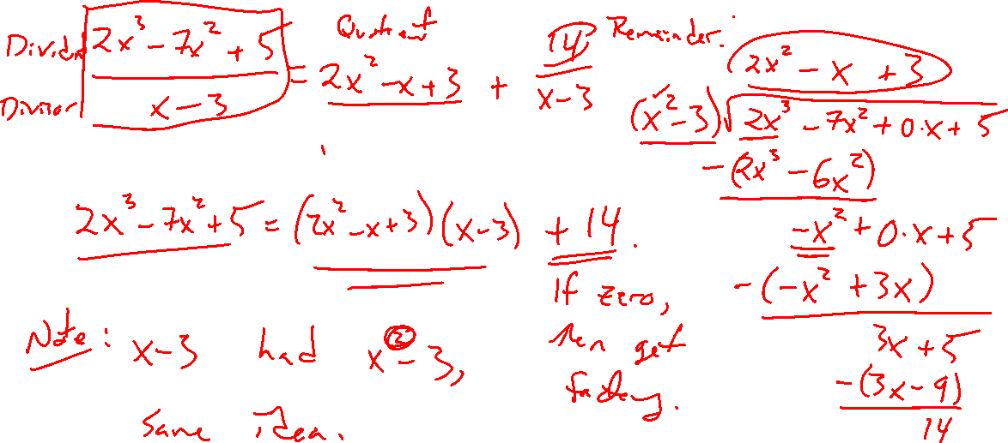
Example: Polynomial Division
Notes:
(2x^3-7x^2+5)/(x-3)
Check via multiplication
Note, if higher degree divisor, can do just as easy
(2x^3-7x^2+5)/(x^2-3)

Slide 5
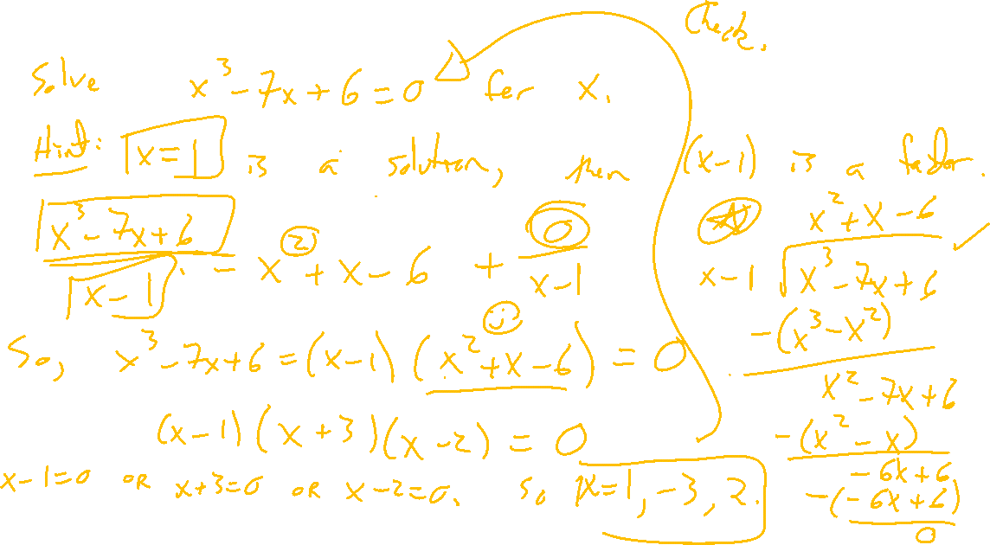
Example: Try on Own
Notes:
Solve x^3-7x+6=0
Note, x=1 is a solution, meaning (x-1) is a factor. Do long division. Expect quotient to be a quadratic.
Check solution via desmos.

Slide 6
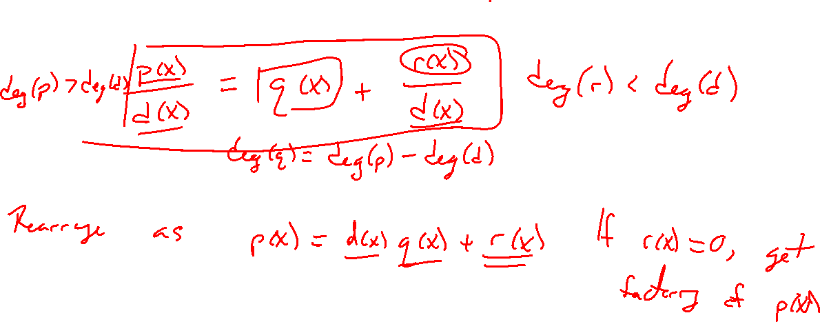
Overview of Polynomial Division
Notes:
P(x)/d(x) = q(x) + r(x)/d(x) terminolgy
P(x) = q(x)d(x) + r(x)
Compare to previous example
Note, if r(x) = 0 then d(x) is a factor of p(x)

Slide 7
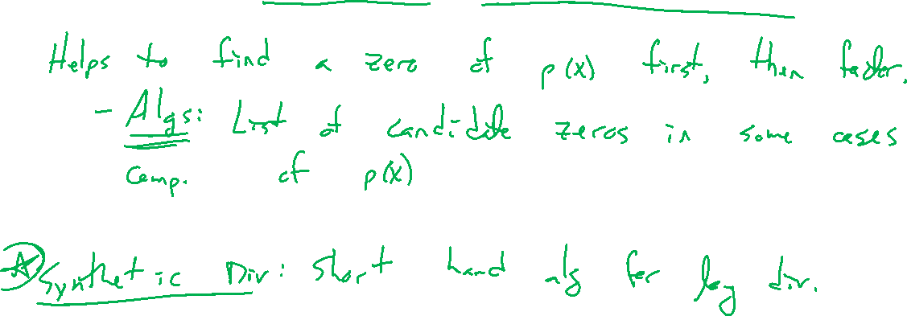
Challenge of Factoring / Synthetic Division

Slide 8
Textbook Examples and Exercises
Rework examples 1, 2, 5, 6 in the text. Steps:
Write down a problem.
Close the book and attempt on own.
Check / correct your solution against the text solution.
If needed, rewrite the problem to be of the quality of the text solution.
Complete exercises 3, 7, 9, 19, 53, 67
Write solutions of the same quality as in lecture and text solutions.
Check your solution against the answer in the back of the book.

Slide 9
Homework Submission to Canvas
Preview of section
Skim the section in text and write a short paragraph summary.
Give a bulleted list of all important definitions, theorems, and formulas without details.
Notes on video lectures
Take notes on everything written on slides including all details, worked examples, on-own activities, as well as your own thoughts and questions.
Try on-own activities first, then write down provided solution next to it for comparison.
Worked examples from the text
Write down the problem and attempt without looking at the solution.
Use the solution to write the best explanation you can.
Solutions to textbook exercises
Model approaches and explanations given in the video lectures and textbook examples.
Final reflection of section
List the key takeaways to remember as a bulleted list.

